Slide 1

Café Management System
(Integrating with Sentiment Analysis)
Presented by:
Kyaw Zay Yar Linn

Slide 2

Agenda
Abstract
Goals & Motivation
Technologies & Theories
Project Architecture
Project Flows
Conclusion

Slide 3

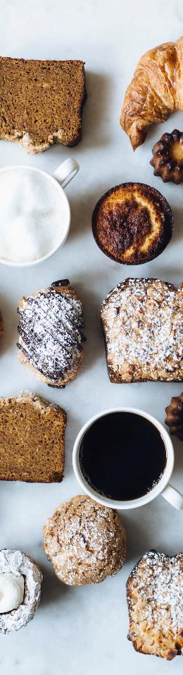

Abstract
This project aims to develop a Cafe Management System integrated with Sentiment Analysis to provide cafe owners an automated solution to manage cafe operations and analyze customer feedback efficiently.

Slide 4


Project Goals & Motivation
Purpose:
Streamline daily cafe operations (menu management, orders, and user management).
Enhance decision making with customer feedback analysis using sentiment detection.
Motivation:
Modernize traditional cafe management by leveraging full-stack development.
Use data-driven insights to improve customer satisfaction and operational efficiency.

Slide 5
Technologies Used
Machine Learning & Data Processing:
Backend:
Frontend:
Java & Spring Boot: RESTful services, dependency injection, and configuration management.
Spring Data JPA & MySQL: Object-relational mapping and persistent data storage.
Spring Security & JWT: Authentication, authorization, and role-based access control.
React: Component-based UI, state management, and routing (React Router).
Chart.js (via react-chartjs-2): Data visualization (line and pie charts).
Tailwind CSS: Rapid styling and responsive design.
Python, Pandas, scikit-learn: Data preprocessing, model training, and evaluation.
TF-IDF & Complement Naive Bayes: Feature extraction and sentiment classification.
Build Tools & Others: Maven for Java dependency management and npm for frontend packages.

Slide 6
Background Theories & Concepts
Natural Language Processing (NLP):
Text preprocessing: removing noise (URLs, punctuation) and normalization (lowercasing, tokenization).
TF-IDF (Term Frequency-Inverse Document Frequency): Converts text to numerical feature vectors by measuring word importance.
Sentiment Analysis:
Using Complement Naive Bayes (an adaptation of Naive Bayes that works well with imbalanced classes) for classifying reviews as positive or negative.

Slide 7
Background Theories & Concepts
Evaluation Metrics:
Accuracy: Overall correctness of predictions.
Precision & Recall: Balance between false positives and false negatives.
F1 Score: Harmonic mean of precision and recall.
Confusion Matrix: Detailed breakdown of prediction performance (TP, FP, TN, FN).
Security Concepts:
JWT-based authentication ensures stateless, secure API calls.
Role-based access control differentiates user privileges (ADMIN vs. USER).

Slide 8
System Architecture
Frontend
React app with dynamic routing and chart visualization.
Backend
Spring Boot REST API handling business logic, security, and data persistence.
ML Microservice
Python-based sentiment analysis service called by the FeedbackController.
Data Flow:
User Actions
REST APIs
Database Updates & ML Processing
Data Visualization on the dashboard

Slide 9
Backend Components
Controllers:
UserController, MenuController, OrderController, FeedbackController, SentimentAnalysisController.
Services & Repositories:
Encapsulate business logic (order processing, user management) and interact with MySQL through JPA.
Security Implementation:
JwtFilter and JwtUtil ensure that endpoints are secured using JWT tokens, with Spring Security configuration handling role-based access.

Slide 10
Backend Logic
Is token valid?
start
API request from frontened
JWT Filter
no
yes
Return unauthorized response
Repository (MySQL)
Invoke service layer
Controller logic
Route request to appropriate controller
Call ML microservice for sentiment analysis
Prepare API response
Send response to frontend
end

Slide 11
Frontend Components
Key Pages:
CustomerLanding: Homepage with cafe introduction and ordering call-to-action.
LoginSignup: Authentication and registration interface.
AdminDashboard: Tabbed navigation for menu management, orders, user management, feedback, sentiment analysis, and best-selling products.
Visualization & UI:
Use of Chart.js (line and pie charts) for dynamic data display.
Responsive design supported by Tailwind CSS for a modern look

Slide 12
Flowchart for the User/Customer Flow
Are credentials valid?
start
Enter login credentials
no
Display error message
yes
View menu
Show order confirmation & receipt
Select items and place order
Display user dashboard
Place order
View order history
Update profile
end

Slide 13
Flowchart for the Admin Flow
Are credentials valid?
start
Enter admin credentials
no
display authentication error
Manage users
yes
Manage orders
display admin dashboard
Logout process
Perform database operations (CRUD)
Manage menu items
View feedback & sentiment analysis
Repository
(MySQL)
end
View best selling products

Slide 14
Sentiment Analysis Integration
• Feedback Process Flow:
Customers submit reviews via the FeedbackController.
Reviews are sent to a Python microservice (via REST call) that predicts sentiment.
Predicted sentiment is stored in the database along with other feedback details.
• Data Aggregation for Visualization:
SentimentAnalysisController aggregates feedback data over time (grouped by day) to provide input for line and pie charts.

Slide 15
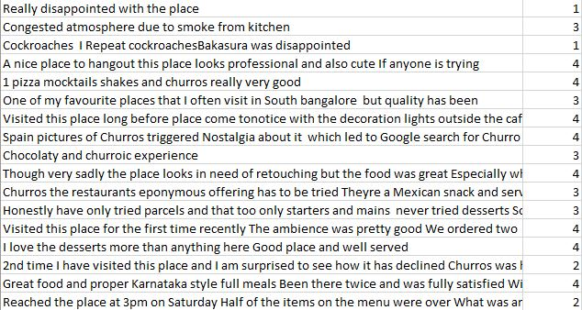
Dataset Features
Data source: Zomato Bangalore Restaurants www.kaggle.com/datasets/himanshupoddar/zomato-bangalore-restaurants
The “ratings.csv” dataset has over 3M+ (3018182) reviews on restaurants and cafes with their ratings (1 to 5).

Slide 16
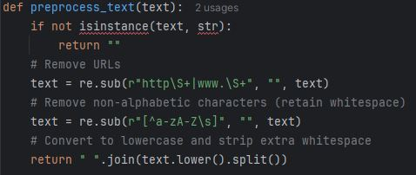
Preprocessing Data
Clean and normalize text data to improve model performance.
Remove URLs : Strip out web links using regex.
"Check out this link: http://example.com " → "Check out this link:"
Remove Non-Alphabetic Characters : Retain only letters and spaces.
"This coffee is $great!" → "This coffee is great"
Convert to Lowercase : Ensure consistency in word representation.
Trim Whitespace : Remove extra spaces and clean up the text.
Tokenization: Split text into tokens (words).
"Great coffee" → Tokens: ["great", "coffee"]
Stopword Removal: Remove common English stopwords (eg., “the”, “and”, “is”)
"The coffee is great" → Tokens: ["coffee", "great"]
* Tokenization and Stopword Removal are handaled by TF-IDF vectorizer.

Slide 17

Building Vocabulary with TF-IDF
What is TF-IDF?
Term Frequency (TF) : Measures how frequently a term appears in a document. A higher count means the term is more important within that specific document.
Inverse Document Frequency (IDF) : Measures how unique or rare a word is across all documents. If a word appears in many documents, its IDF is low; if it’s rare, its IDF is high. It’s purpose is to penalizes terms that appear too frequently across all documents.
TF (t,d) = $\frac{Number of times term t appears in document d}{Total number of terms in document d}$
IDF (t) = log ($\frac{Total number of documents}{Number of documents that contain the term t}$)
TF-IDF (t,d) = TF (t,d) × IDF(t)
TF-IDF Weight : Combined score emphasizes important words while ignoring common ones like "the", "and". It reduces noise by removing stopwords and captures important terms based on their frequency and rarity.

Slide 18

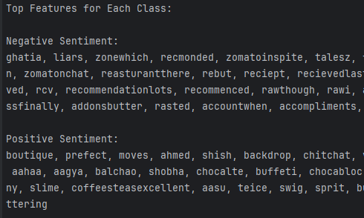
Building Vocabulary with TF-IDF
For example, document 1 = "the espresso at the cafe is rich and smooth“
document 2 = "i love the latte and the cozy ambiance of the cafe“
Term Frequency (TF): "espresso“ = ¼ = 0.25
"latte“ = 1/5 = 0.2
"cafe“ = ¼ = 0.25
Inverse Document Frequency (IDF): “espresso” = log (2/1) = log (2) = 0.693
“latte” = log (2/1) = log (2) = 0.693
“café” = log (2/2) = log (1) = 0
TF-IDF: “espresso” = 0.25 * 0.693 = 0.241
“latte” = 0.2 * 0.693 = 0.139
“café” = 0.25 * 0 =0
This is how TF-IDF distinguishes weight for each terms in the analysis, distinctive terms like "espresso" or "latte" will have more weight, while common words like "cafe" will have little to no impact.

Slide 19

What is Naïve Bayes?
A probabilistic machine learning algorithm used for classification tasks.
Uses Bayes' theorem with an assumption of independence between features.
P(C | X) = $\frac{P\left(X \right|C).P(C)}{P(X)}$
P(C∣X): Probability of class C given input X.
P(X∣C): Likelihood of observing X in class C.
P(C): Prior probability of class C.
P(X): Evidence (normalizing constant).
Naïve Bayes Classifier : attributes are conditionally independent.
For a new review, calculate P(Positive | Review) and P(Negative | Review). Choose the class with the highest probability.
Its formula: P (Ci|X) = $\prod_{k=1}^{n}{P \left(Xk \right|Ci)∗P(Ci) }$
Input Data → Feature Extraction → Calculate Probabilities → Predict Class

Slide 20
How Naïve Bayes Work?
For example: Doc1 (Positive): “i love the coffee”
Doc2 (Positive): “the coffee is amazing”
Doc3 (Negative): “the coffee is terrible”
After removing stop-words and tokenization, our vocabulary is: [love, coffee, amazing, terrible]
P(Positive)= 2/3​ = 0.667 , P(Negative)= 1/3 = 0.333
P(love∣Positive)=​ ½ = 0.5 , P(coffee∣Positive)= 2/2 =1 , P(amazing|Positive)= ½ = 0.5 , P(terrible|Positive)= 0/2 =0
P(love∣Negative)= 0/1 = 0 , P(coffee|Negative) = 1/1 =1 , P(amazing|Negative)= 0/1 = 0, P(terrible|Negative)= 1/1 = 1
Suppose we get a new review: “love the coffee”
After removing stop-words and tokenization: [“love”, “coffee”]
P(Positive|”love the coffee”)= P(love|Positive) * P(coffee|Positive) * P(Positive) = 0.5 * 1 * 0.667 = 0.334
P(Negative|”love the coffee”)= P(love|Negative) * P(coffee|Negative) * P(Negative) = 0 * 1 * 0.333 = 0
Since P(Positive|”love the coffee”) > P(Negative|”love the coffee”), the Naïve Bayes classifier chooses Positive for the new review “love the coffee”.

Slide 21
Why choosing Naïve Bayes?
In this project, we need to classify customer reviews (e.g., “I love the coffee”, “The coffee is terrible”) into positive or negative sentiment.
Naive Bayes uses the frequencies of key words (like “love,” “amazing,” “terrible”) and computes the likelihood of a review belonging to a sentiment class.
Words in reviews often carry strong sentiment signals, and Naive Bayes effectively leverages these signals to produce accurate predictions.
The probabilistic output (posterior probabilities for each class) is intuitive and easy to interpret.
You can see which words contribute most strongly to the decision and understand the model’s predictions, which is important when explaining results to non-technical stakeholders.
Limitations of Naïve Bayes:
Independence Assumption : Assumes all features are independent, which may not always hold true.
Imbalanced Data : Performs poorly when one class dominates the dataset.
Rare Words : Struggles with words that rarely appear in the training data.

Slide 22
Introducing Complement Naïve Bayes
What is CNB? : A variant of Naive Bayes designed for imbalanced datasets.
Key Difference : Focuses on complement features (features absent in a class) instead of just present features.
Why Use Complement Naive Bayes?
Imagine you have a dataset of customer reviews for a café. If most customers are happy and leave positive reviews, a standard Multinomial Naive Bayes might bias predictions toward the majority class.
ComplementNB, on the other hand, would consider the "complement" of the positive class (i.e., the negative class) more effectively, ensuring that signals from less frequent negative reviews are not overlooked.
This helps in accurately classifying a review like "The coffee is terrible," even if such negative words occur less frequently overall.
Choosing ComplementNB is advantageous when:
The training data is imbalanced.
We need a model that is both fast and reasonably accurate for high-dimensional text data.
We want improved generalization and robustness, particularly when distinguishing minority classes in a text classification task.

Slide 23

How ComplementNB Works?
The CNB Algorithm:
1. Feature Extraction: Same as Naive Bayes (TF-IDF).
2. Training :
Computes P(Not Positive | Review) and P(Not Negative | Review).
Adjusts probabilities to account for imbalanced data.
3. Prediction :
Calculates the complement probability for each class.
Chooses the class with the lowest complement probability.
Its formula: P (Ci|X) = $\prod_{k=1}^{n}{ (1 −P \left(Xk \right|Ci)∗P(Ci)) }$
CNB focuses on what makes a review unlike a certain class.
For example, it checks how unlike a review is to being negative, then decides if it’s positive.

Slide 24
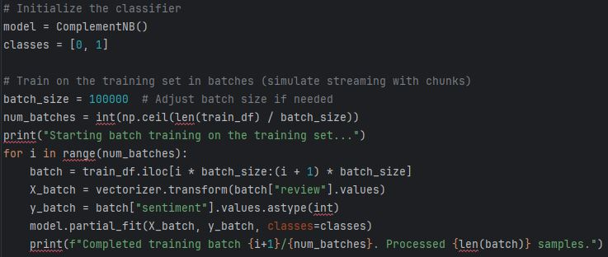
Implementation in this Project
Preprocessing : Clean and normalize text data using preprocess_text.
Vectorization : Convert text into TF-IDF vectors.
Batch Training : Train the model incrementally using partial_fit to handle large datasets.
Prediction : Use the trained model to predict sentiment for incoming feedback.

Slide 25
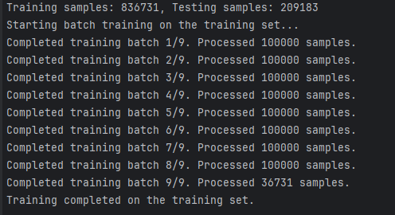
Batch Training with Complement NB
Challenges : The dataset contains over 3 million rows. Loading the entire dataset into memory is impractical.
Solution : Used partial_fit from scikit-learn's ComplementNB. Processed the training data in chunks (e.g., 100,000 rows per batch).
Dataset splitting: Used train_test_split from scikit-learn and split the data into 80% for training,
20% for testing to ensure the model generalizes well to unseen data. This prevent overfitting by evaluating on a separate test set.

Slide 26

Evaluation Metrics
Accuracy:
Accuracy is the proportion of correctly predicted instances (both positive and negative) out of the total instances.
Accuracy = $\frac{True Positives+True Negatives}{Total Samples}$
Measures overall correctness but may not reflect class-specific performance.
Example: If the model predicts 900 reviews correctly out of 1,000, accuracy = 90%.
Advantage: Simple to understand and compute.
Limitation: Can be misleading with imbalanced datasets (e.g., if 90% of reviews are positive, predicting all as positive would yield 90% accuracy despite not capturing any negatives).

Slide 27

Evaluation Metrics
Precision:
Precision measures the proportion of correct positive predictions out of all positive predictions made by the model.
Precision = $\frac{True Positives}{True Positives+False Positives}$
How reliable is the model when it predicts "Positive"?
Example: If the model predicts 500 positive reviews and 450 are correct, precision = 90%
High precision means that when the model predicts a review is positive, it is usually correct.
Limitation: It doesn’t account for how many actual positives were missed.

Slide 28

Evaluation Metrics
Recall:
Recall (or Sensitivity) measures the proportion of actual positive cases that were correctly identified by the model.
Recall = $\frac{True Positives}{True Positives+False Negatives}$
How well does the model identify all positive reviews?
Example : If there are 600 actual positive reviews and the model identifies 500, recall = 83.3%.
High recall means most of the actual positive reviews are captured.
Limitation: It may come at the cost of lower precision if the model starts predicting positives too liberally.

Slide 29

Evaluation Metrics
F1 Score:
The F1 score is the harmonic mean of precision and recall. It provides a single metric that balances both precision and recall.
F1 Score = 2 ×$\frac{Precision\text{×}Recall}{Precision+Recall}$
The F1 score is particularly useful when you need to balance precision and recall, especially in the presence of class imbalance.
Example : If Precision = 90% and Recall = 83.3%, F1-Score ≈ 86.6%.

Slide 30
Evaluation Metrics
Confusion Matrix:
A confusion matrix is a table that provides a detailed breakdown of the model’s prediction performance by showing the counts of true positives (TP), false positives (FP), true negatives (TN), and false negatives (FN).
True Positives (TP) : Positive reviews correctly classified as positive.
True Negatives (TN) : Negative reviews correctly classified as negative.
False Positives (FP) : Negative reviews incorrectly classified as positive.
False Negatives (FN) : Positive reviews incorrectly classified as negative.
The confusion matrix provides granular insight into what types of errors your model is making.
For instance, if FP is high, your model may be overpredicting positive sentiment, and if FN is high, it may be missing out on positive reviews.
 | Predictive Positive | Predictive Negative
Actual Positive | True Positives (TP) | False Negatives (FN)
Actual Negative | False Positives (FP) | True Negatives (TN)

Slide 31
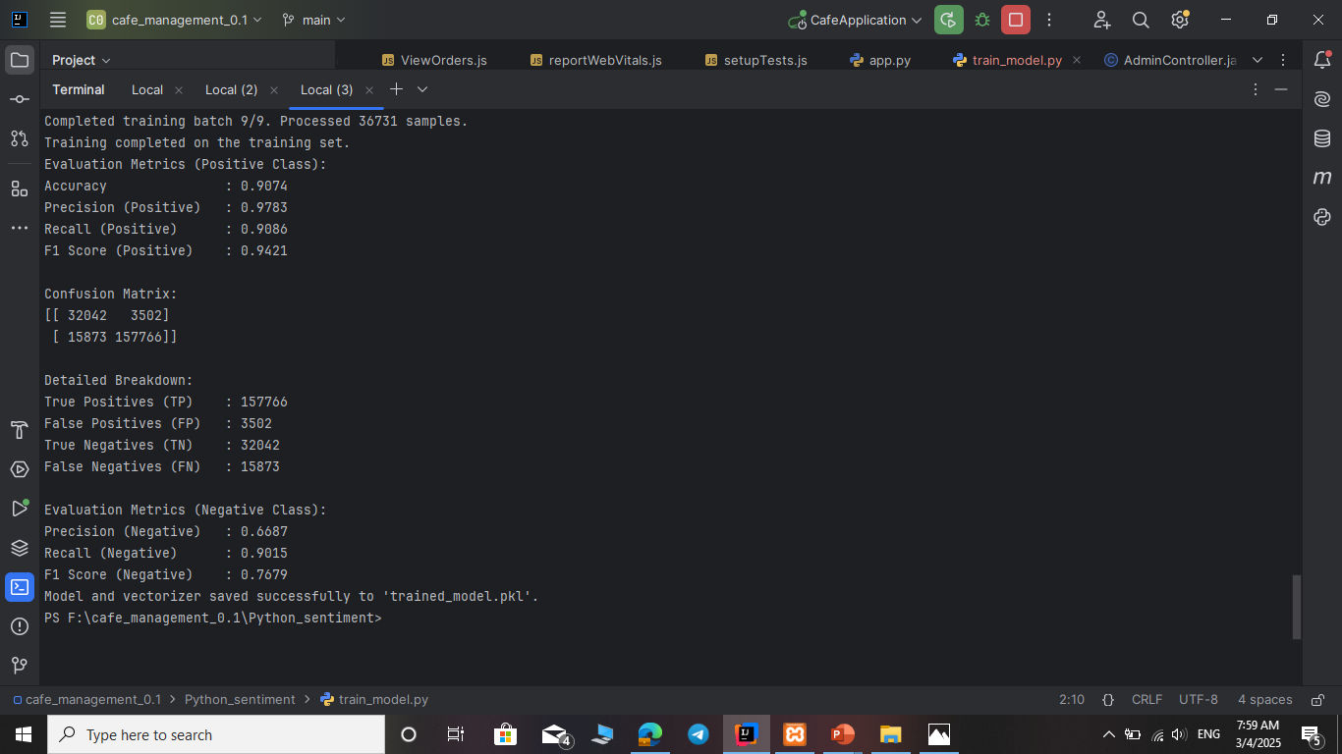
Evaluating the Sentiment Analysis Model
Results and detailed breakdown of each class:

Slide 32
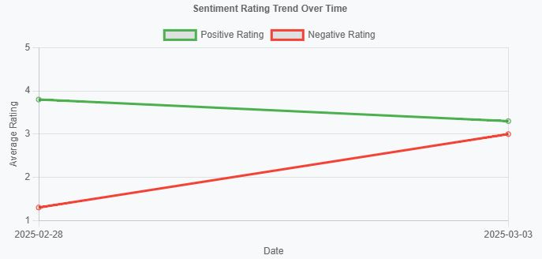
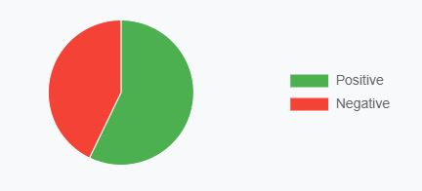
Visualization Components
Data fetched from the backend endpoint /api/sentiment/trend.
Implemented using react-chartjs-2 with dynamic responsiveness.

Slide 33
Challenges & Future Enhancements
Challenges Faced:
Performance issues while handling 3M+ feedback records. Had to chunked data for processing.
JWT Token management: CORS misconfigurations, Token refresh logic.
Future Enhancements:
Can deploy LSTM/Transformer models for higher accuracy.
Extend model evaluation with cross-validation and parameter tuning.
Enhance the user interface with more detailed admin insights and reporting features.

Slide 34


Conclusion
A robust full-stack cafe management system with integrated sentiment analysis was developed.
Combines modern backend security, responsive frontend design, and machine learning for actionable insights.

Slide 35

Thank You !
Kyaw Zay Yar Linn (UIT-1079)
kyawzayyarlinn@uit.edu.mm

